Slide 1
convolutional neural network
“CNNs use a variation of multilayer perceptron's designed to require minimal preprocessing. They are also known as shift invariant or space invariant artificial neural networks (SIANN), based on their shared-weights architecture and translation invariance characteristics.”
Reference: https://en.wikipedia.org/wiki/Convolutional_neural_network

Slide 2
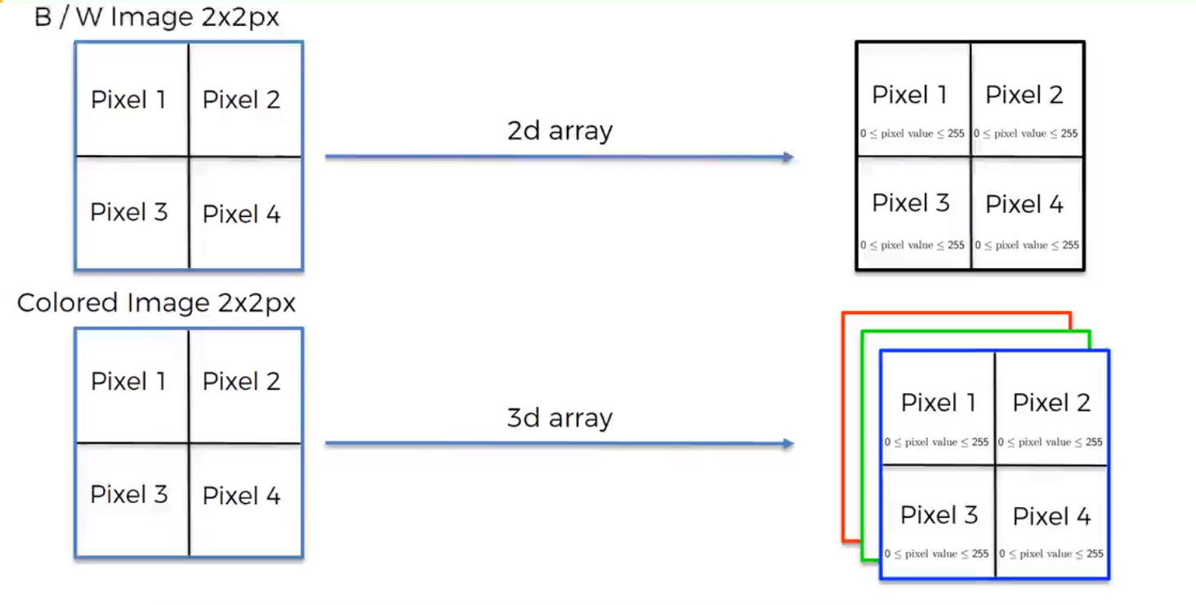
Image Representation
Reference: www.superdatascience.com

Slide 3
Steps Involved
Convolution
Max Pooling
Flattening
Full Connection

Slide 4
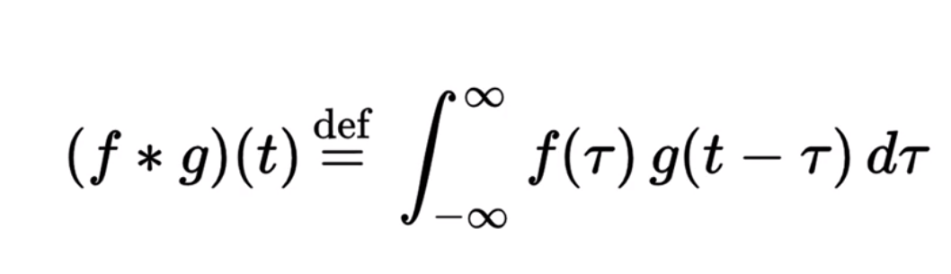
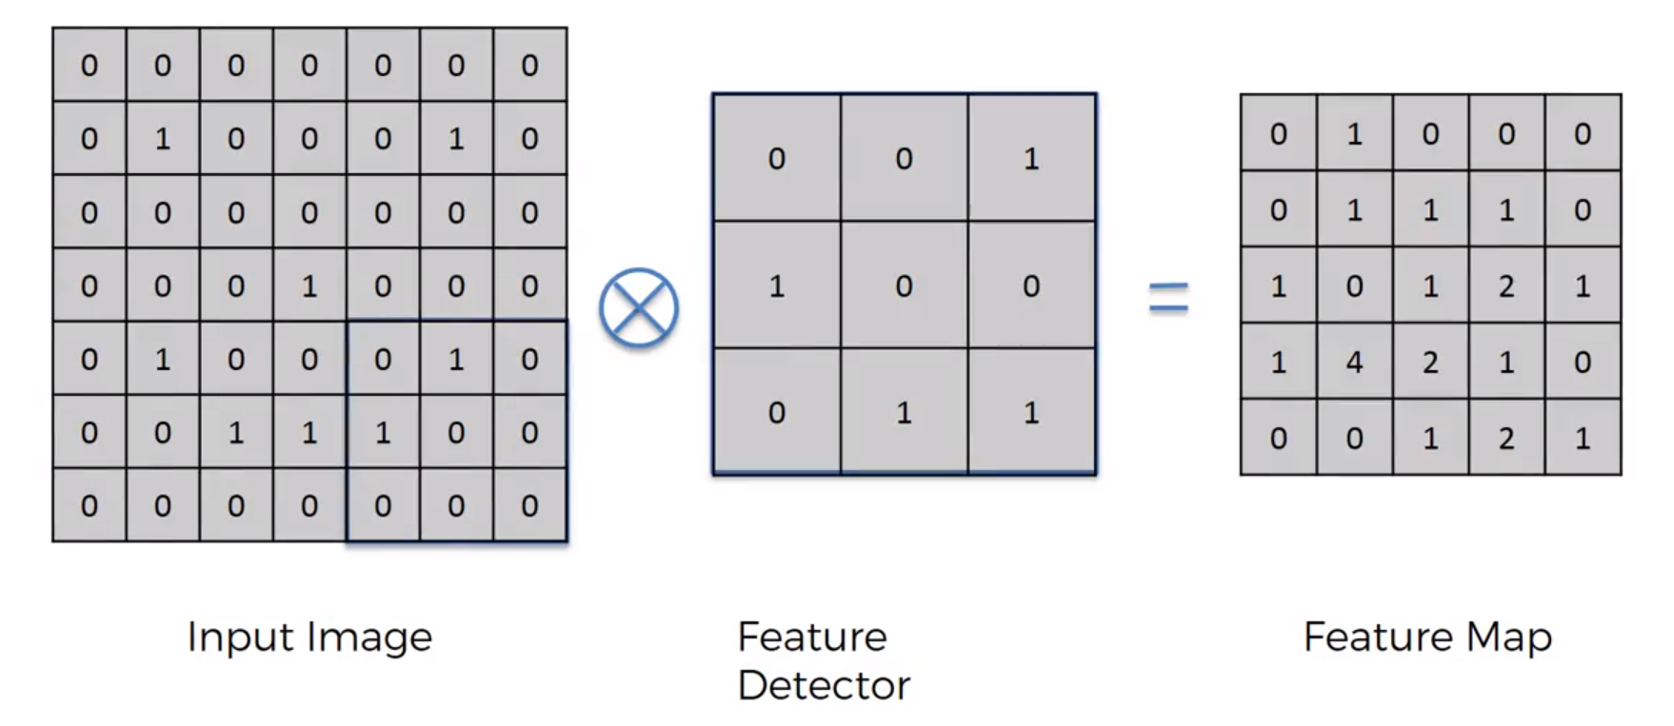
Step 1 – Convolution
The motive here is to make the image smaller for better evaluation. But, there is a loss of information.
Reference: www.superdatascience.com

Slide 5
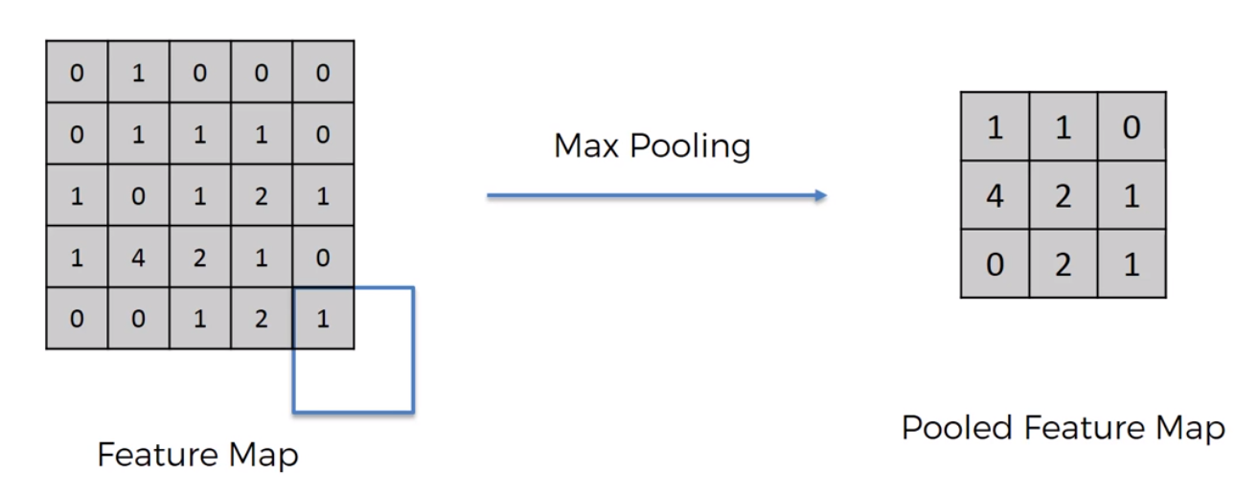
Step 2 – Pooling/ Down Sampling
Reference: www.superdatascience.com

Slide 6
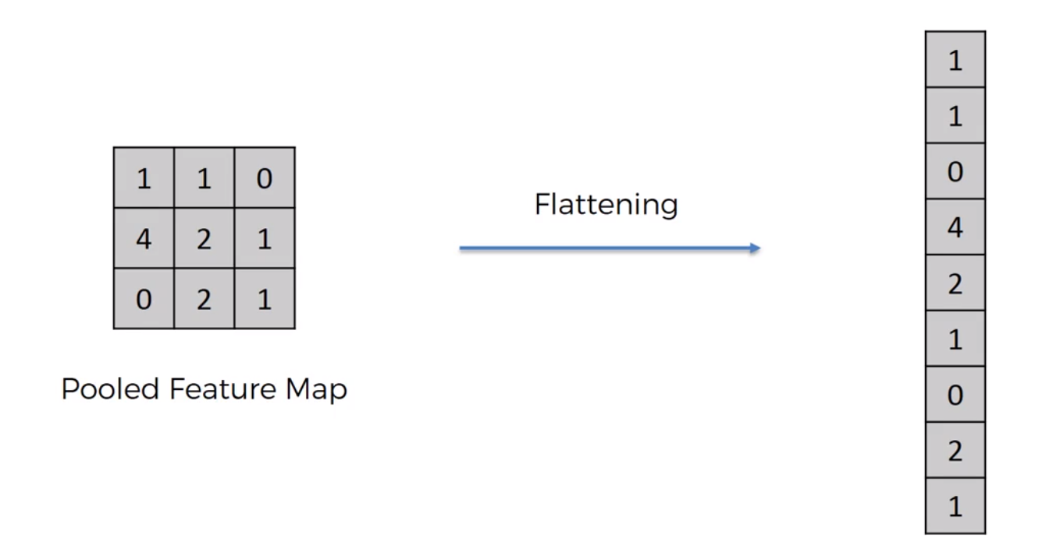
STEP 3 – Flattening
Reference: www.superdatascience.com

Slide 7
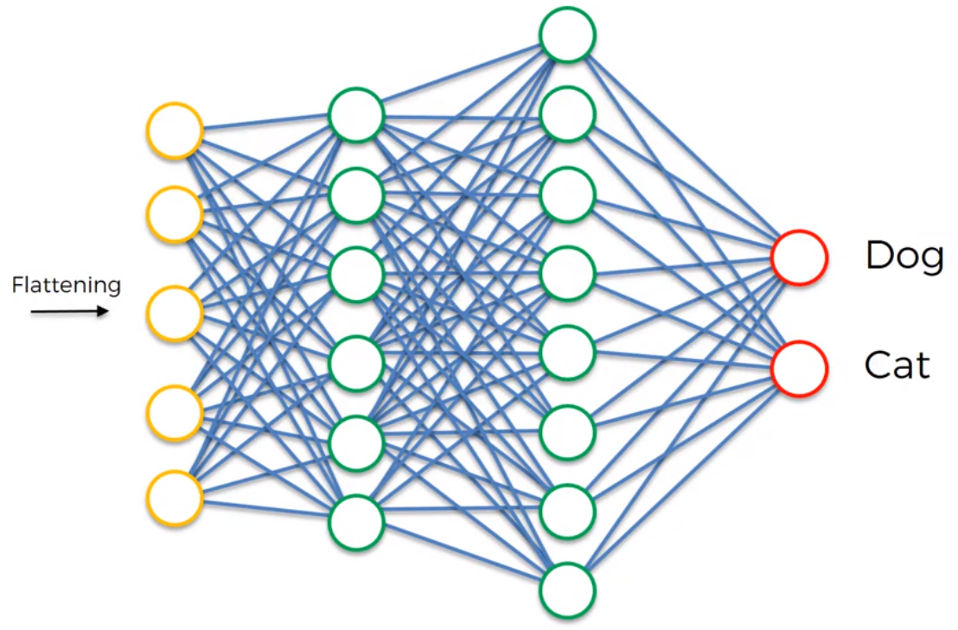
STEP 4 – FULL CONNECTION
Reference: www.superdatascience.com

Slide 8
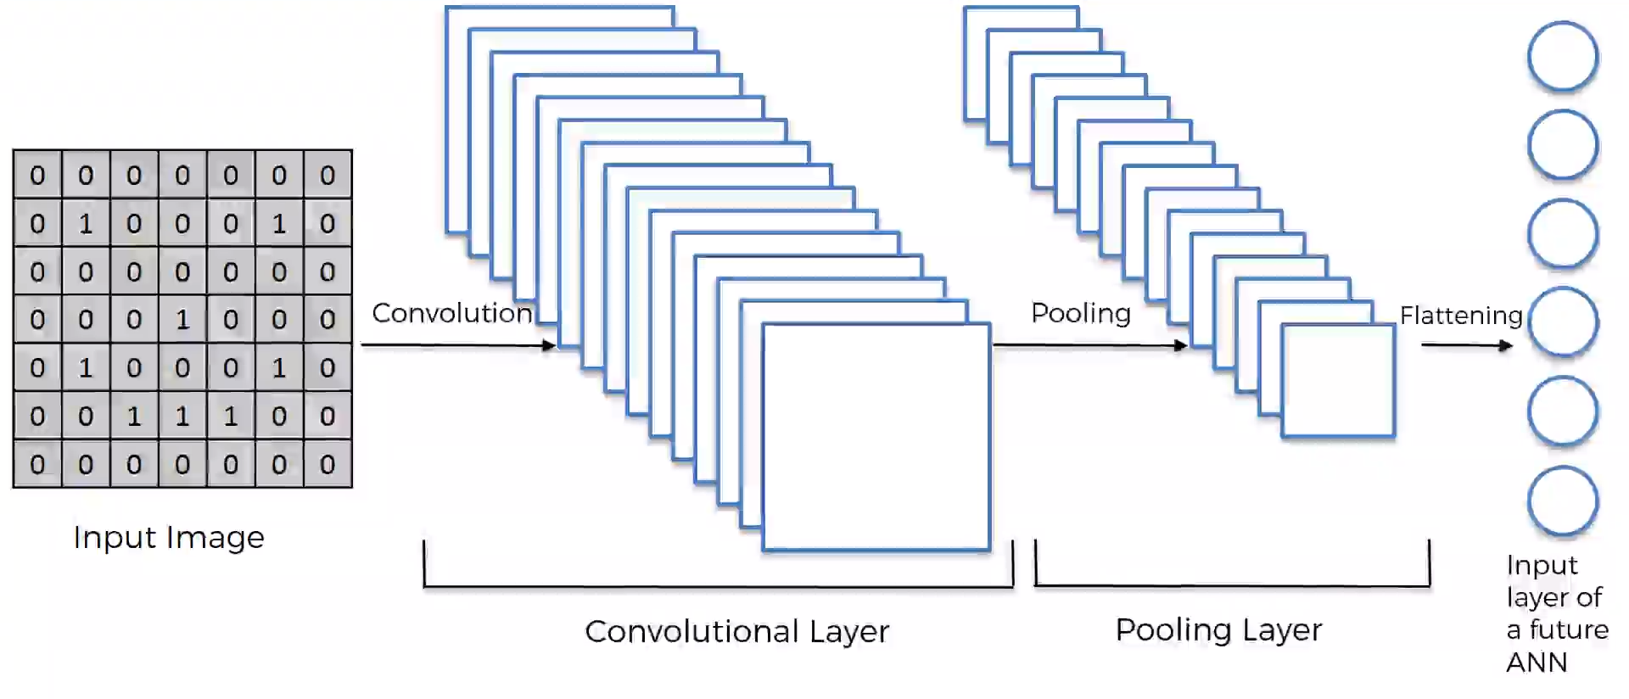
Reference: www.superdatascience.com

Slide 9
Thank you

